Slide 1
React Native
Prepared by: SO Vengleab

Slide 2
Before talking about React Native

Slide 3
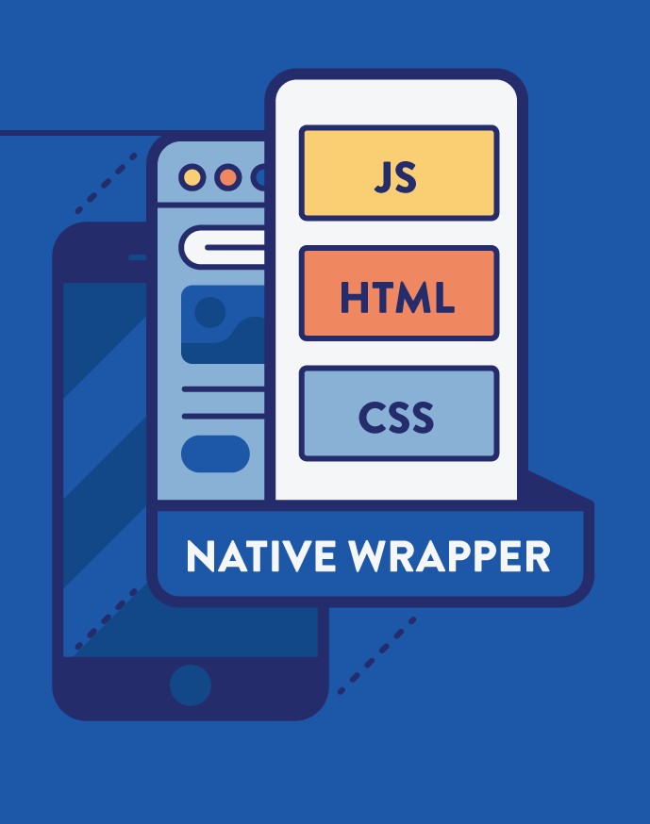
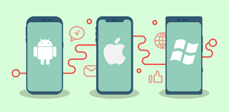
What is Native vs Hybrid app
Notes:
https://codeburst.io/native-app-or-hybrid-app-ca08e460df9

Slide 4
What is Native app
Developed to perform some specific task on particular environment or platform, such as
Android app built using Java Development Kit on Java platform,
iOS app built using iOS SDK, Swift and Objective
Windows platform: using C. Similarly, .NET
Notes:
https://codeburst.io/native-app-or-hybrid-app-ca08e460df9

Slide 5
What is Hybrid app
At core, websites packaged into a native wrapper.
look and feel like a native app, but ultimately outside of the basic frame.
Basically, just a web app built using HTML5 and JavaScript, wrapped in a native container
Notes:
https://ymedialabs.com/hybrid-vs-native-mobile-apps-the-answer-is-clear

Slide 6
Pros and Cons ( Hybrid and Native )
Hybrid
Time & Cost
Maintenance
Code base
Native APIs
Native
Native Functionality
Performance
User Experience
Documentation and Support
Notes:
https://themanifest.com/mobile-apps/hybrid-apps-vs-native-apps-which-should-you-build

Slide 7
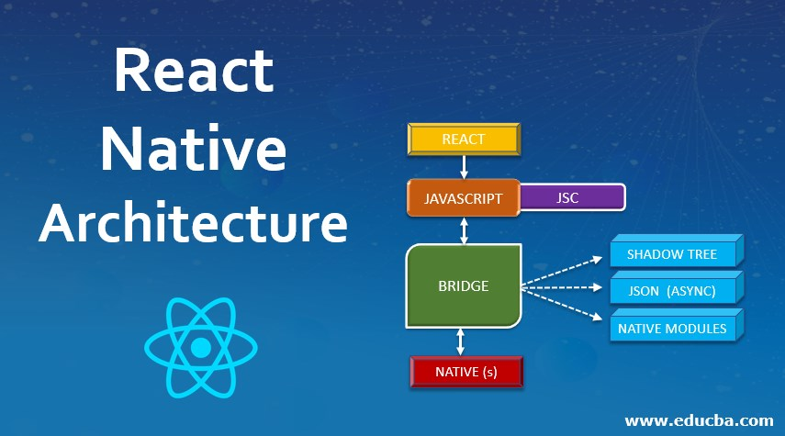
What is React Native?
Notes:
https://reactnative.dev/
https://www.educba.com/react-native-architecture/
https://reactnative.dev/docs/intro-react-native-components

Slide 8
What is React Native
An open source framework for building Android and iOS applications using React
Build app platform with native capabilities.
Use JavaScript to access your platform’s APIs to describe the appearance and behavior of your UI using React Native components
Notes:
https://reactnative.dev/
https://www.educba.com/react-native-architecture/
https://reactnative.dev/docs/intro-react-native-components

Slide 9
Environment Setup ( MacOS)
Step 1: Install brew
Step 2: install dependency
# Install watchman
brew install node # v14+
brew install watchman
# install java
brew tap homebrew/cask-versions
brew install --cask zulu11
Step 3:
Android: Download android studio
iOS: install xcode
Step 4: Setup android or ios development
Step 5 ( Android Only): Create Emulator

Slide 10
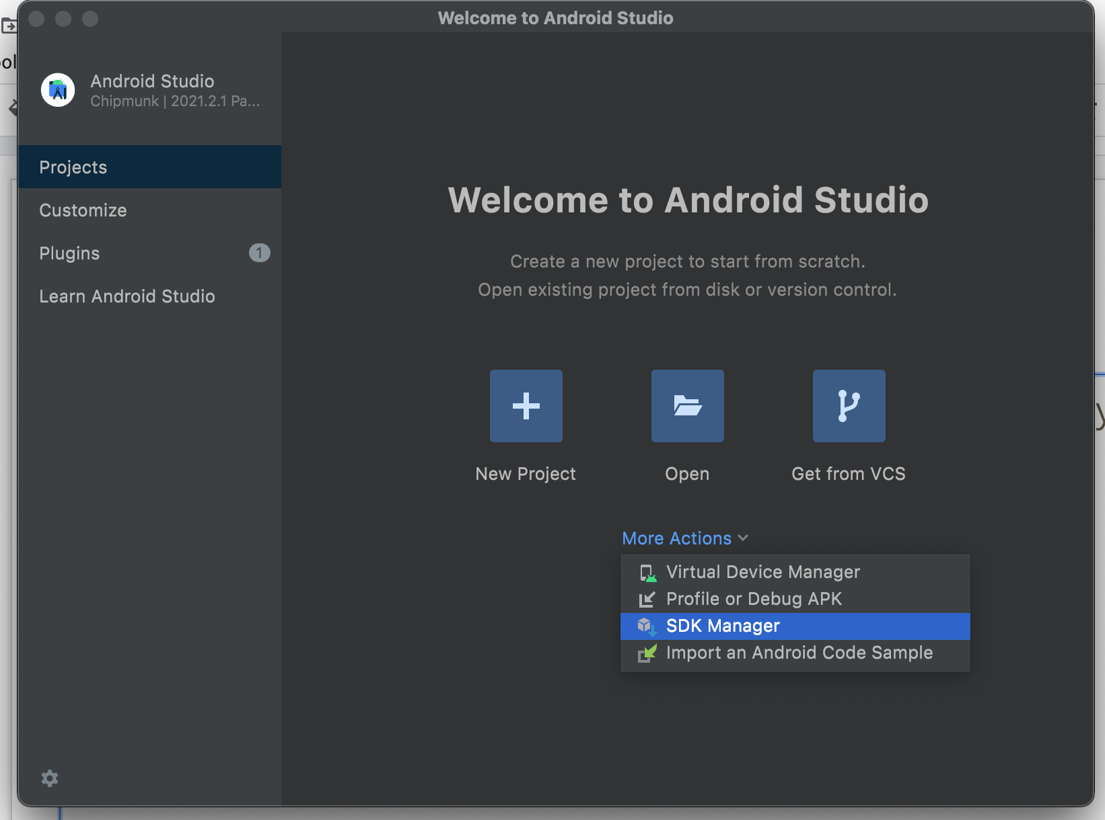
Environment Setup ( MacOS)

Slide 11
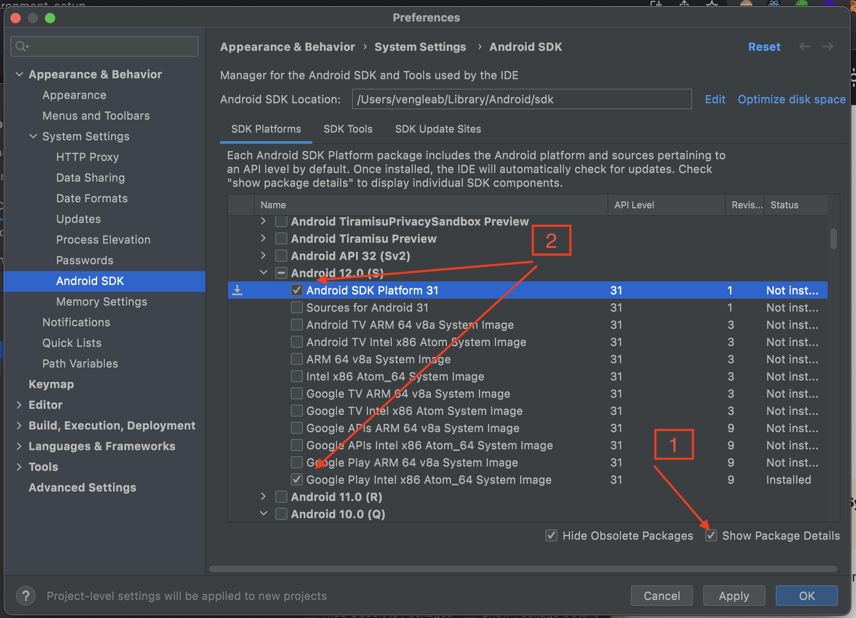
Environment Setup ( MacOS)

Slide 12
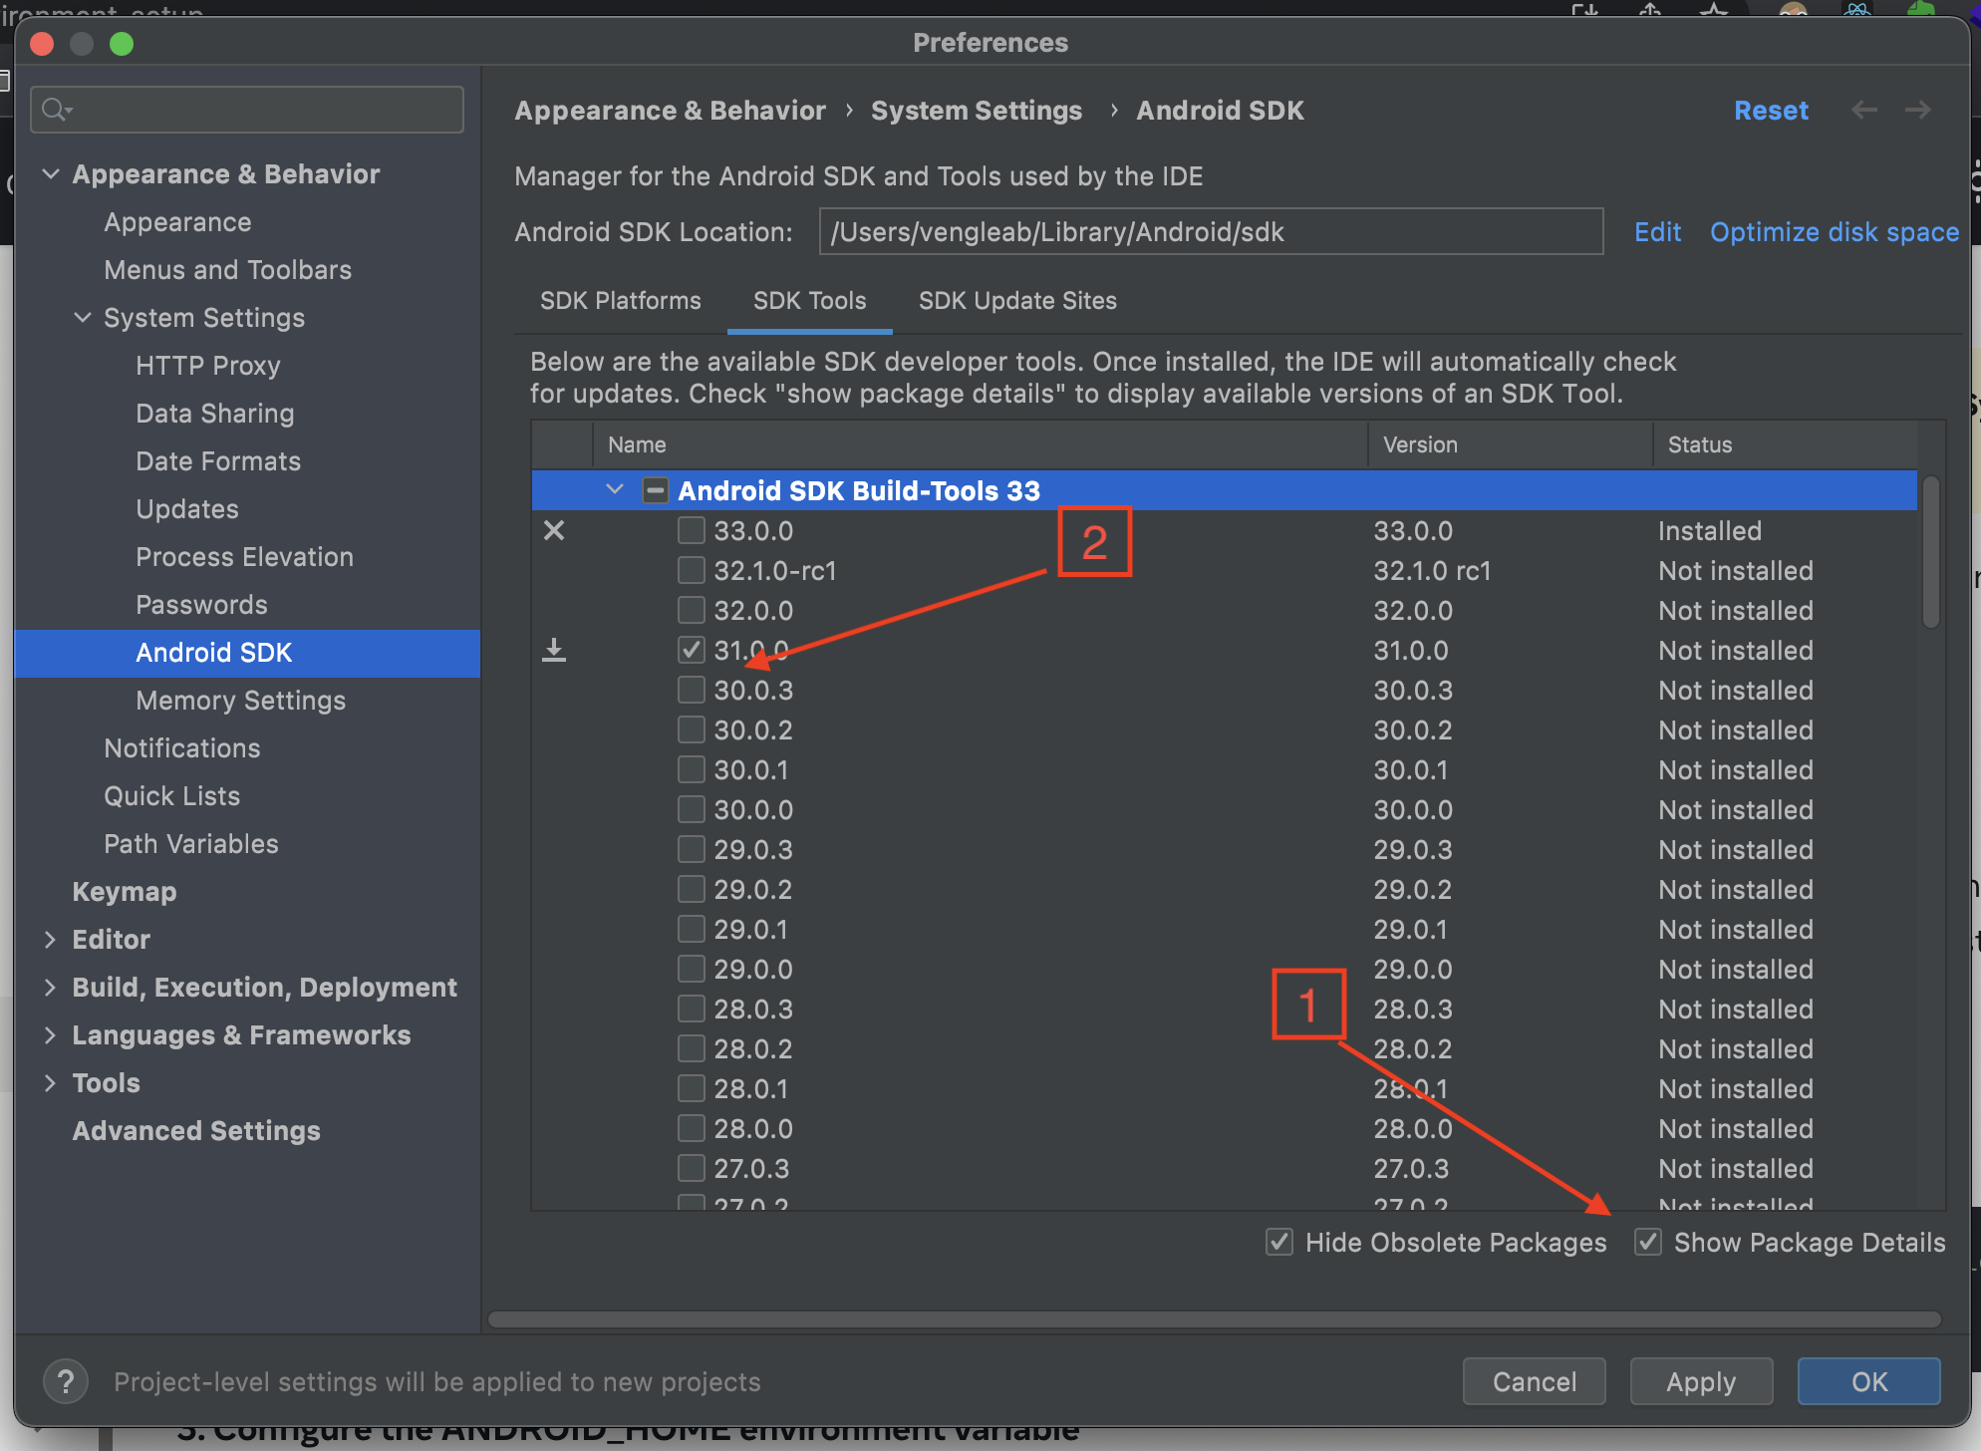
Environment Setup ( MacOS)

Slide 13
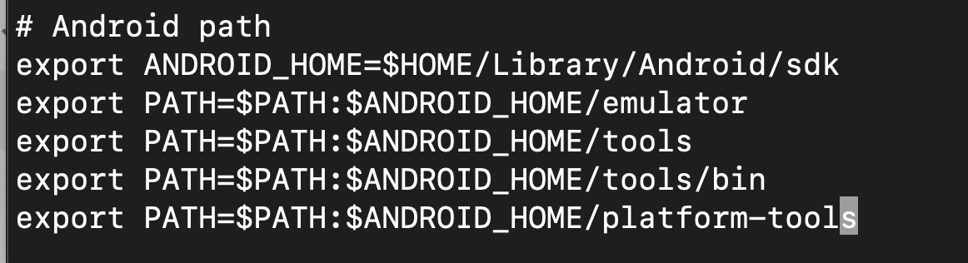
Environment Setup ( MacOS)
Add environment path:
In temital type: vim ~/.zshrc
Add lines below by type letter i : Link
Escape and type :x to save
In temital type: source ~/.zshrc
Test whether it works: adb devices

Slide 14
Setup android development
Accept the certificate base on your selected version (no need on windows):
Notes:
sdkmanager "platforms;android-31" "system-images;android-31;default;x86_64" "system-images;android-31;google_apis;x86"
sdkmanager "cmdline-tools;latest" "build-tools;31.0.0"

Slide 15
Environment Setup for Windows
Step 1: Install JDK and Node
Install Java version 11+
Install node 14+
Step 2: Setup Android development ( the same as mac, refer to previous slide)
Step 3: Add environment path ( Windows PC ), watch link below:
https://www.youtube.com/watch?v=Zf2bvy3kzE4

Slide 16
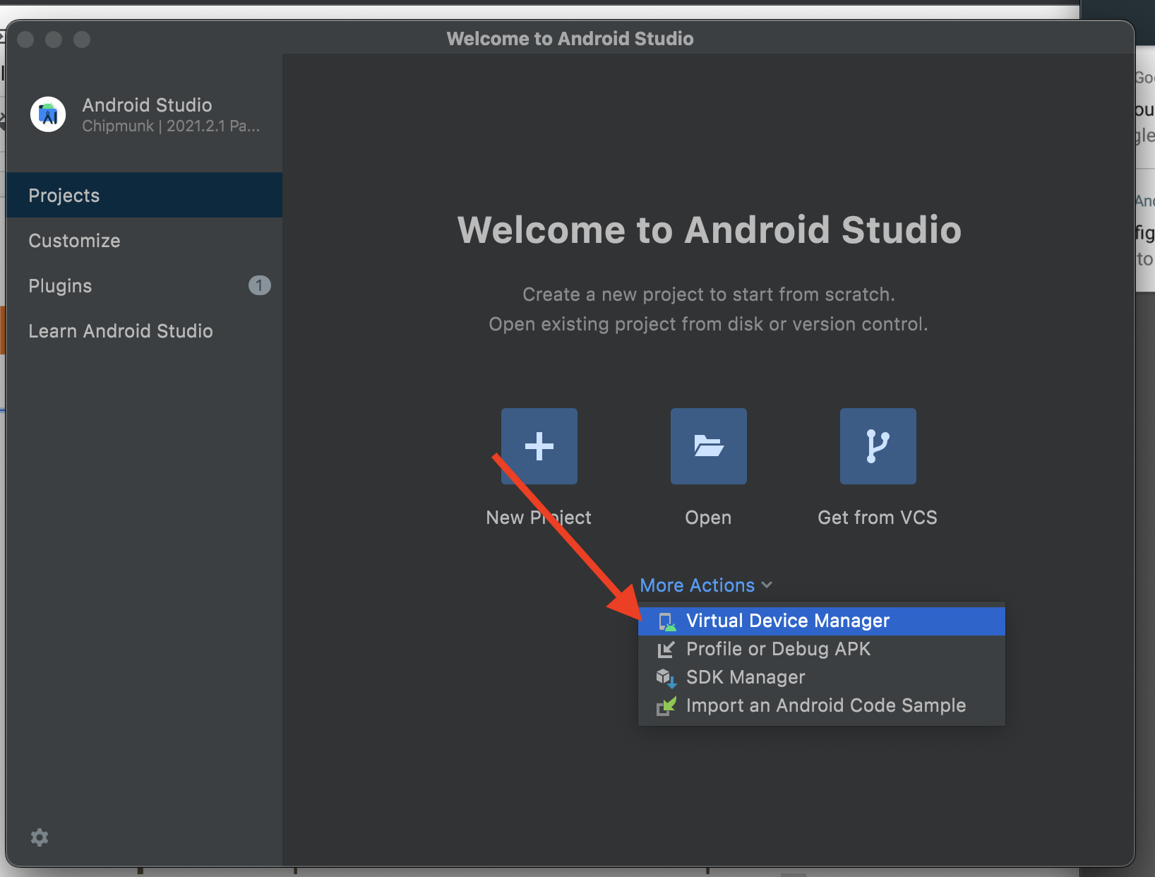
Create Emulator

Slide 17
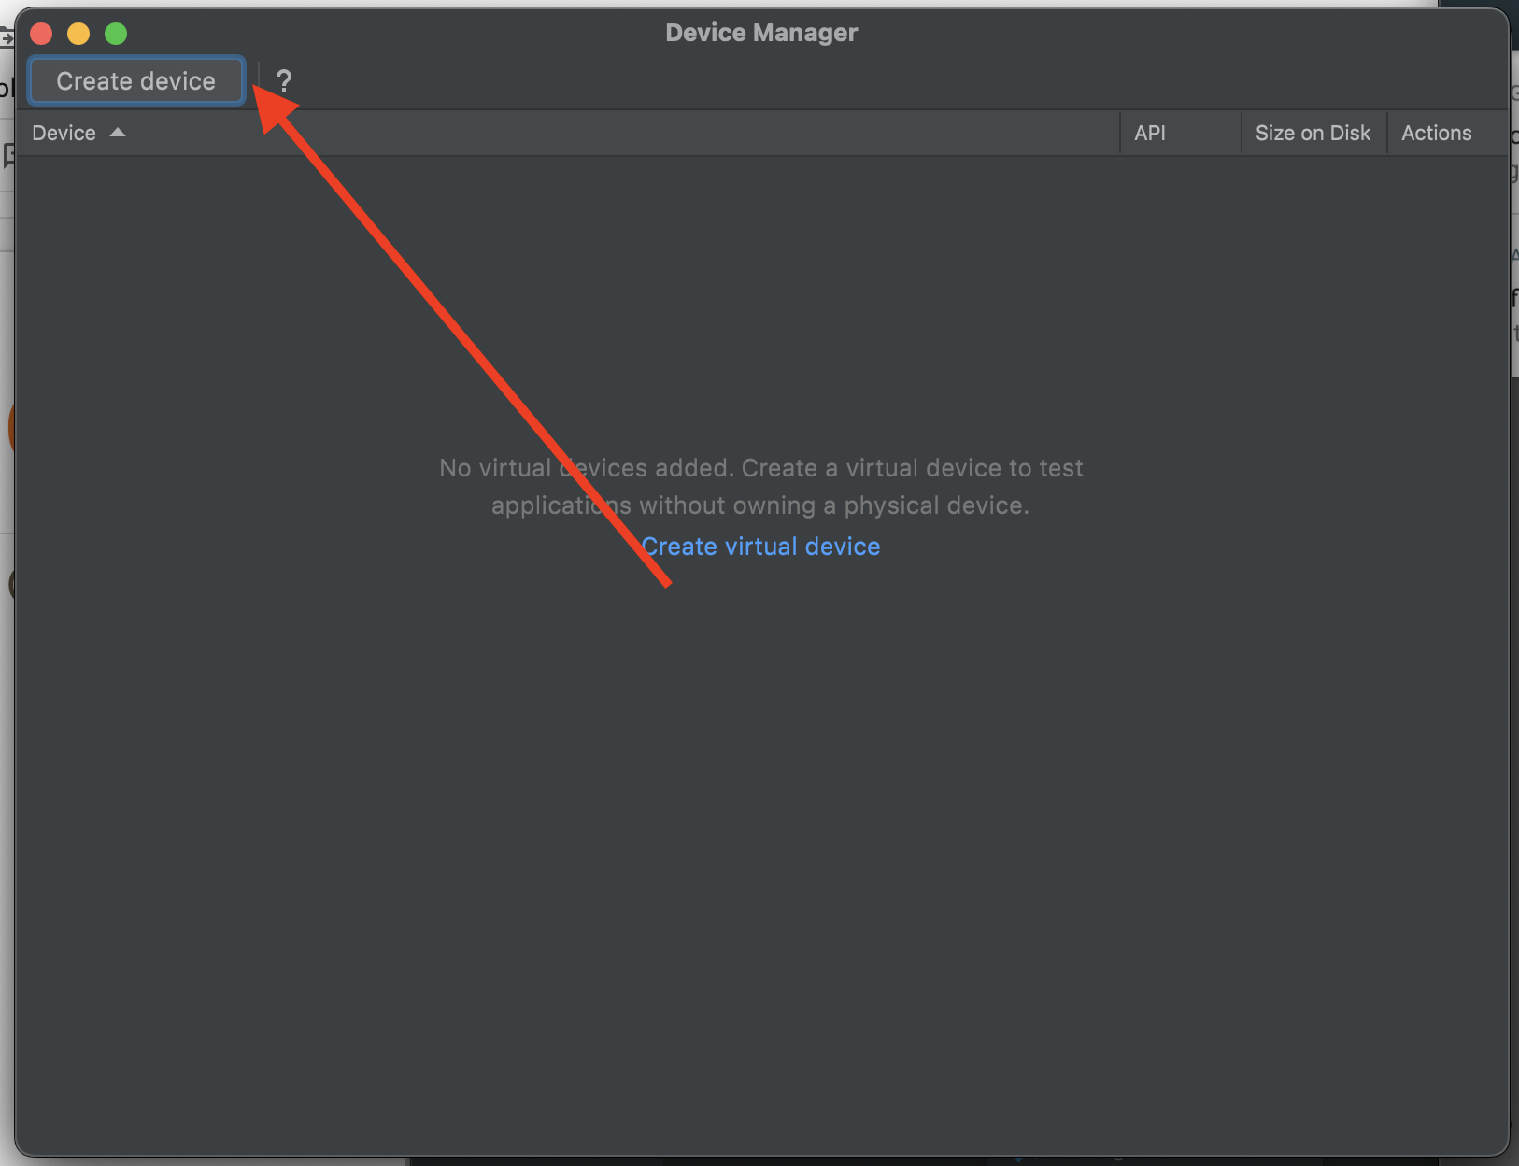
Create Emulator

Slide 18
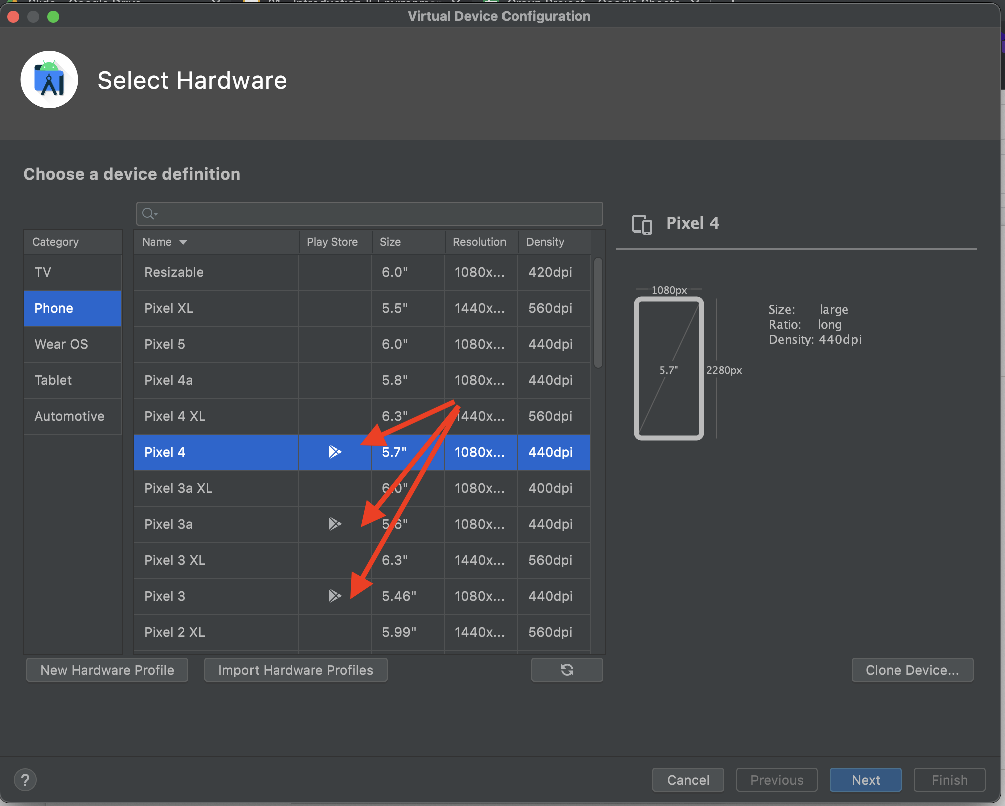
Create Emulator

Slide 19
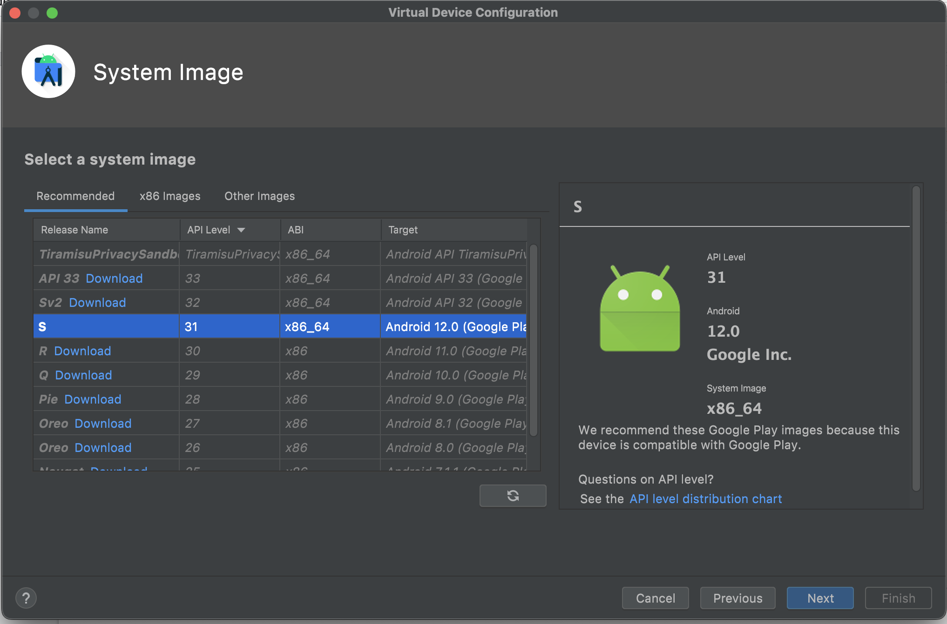
Create Emulator

Slide 20
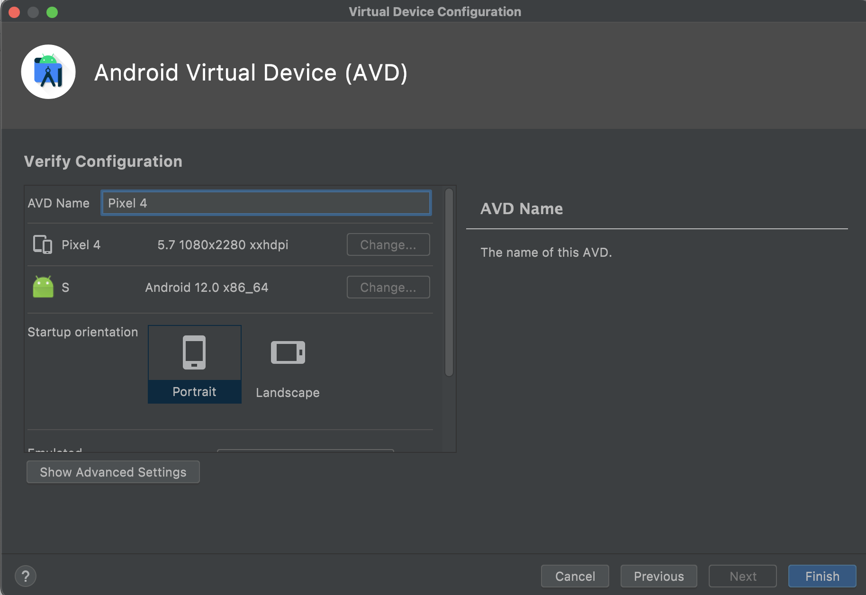
Create Emulator

Slide 21
Create and run project
npx react-native init MyProjectName --version 0.68
npm run ios
npm run android

